Slide 1


Baseball II
Produced by Dr. Mario | UNC STOR 538

Slide 2



Pythagorean Theorem
WP = Win %
RS = Runs Scored
RA = Runs Allowed
Classic Pythagorean Theorem
Relationship Between the Sides of a Right Triangle
$c^{2}=a^{2}+b^{2}$
What is Known: More Runs = More Wins
Relationship Between Runs and Wins?
Bill James’ Pythagorean Method
Example: Kansas City in 2014 World Series
651 Runs Scored
624 Runs Allowed
$$WP≈ \frac{RS^{2}}{RS^{2}+RA^{2}}$$
$$89 Wins≈162× \frac{651^{2}}{651^{2}+624^{2}}=84.43$$

Slide 3



Pythagorean Theorem
WP = Win %
RS = Runs Scored
RA = Runs Allowed
Optimization of Relationship
What is the Best Choice of α?
Minimization of Mean Absolute Deviation (MAD)
Optimal: $α=1.8$ (MAD=0.0199)
Alternative Expression
Forecasting Playoff Series Winners (2005-2016)
Pythagorean Method: 54.8% Accurate
Games Won Approach: 55% Accurate
Interesting Case: 2005 Nationals
$$WP= \frac{RS^{α}}{RS^{α}+RA^{α}}+ε$$
Error
$$WP= \frac{(R{S/RA)}^{α}}{(R{S/RA)}^{α}+1}+ε$$

Slide 4


Pythagorean Theorem
WP = Win %
RS = Runs Scored
RA = Runs Allowed
Useful for Valuing Players in Trades
Example: Cleveland Guardians
Currently: RS=870 and RA=800
Trade Bing Crosby (100 Runs)
For Frank Sinatra (120 Runs)
Difference: +20 Runs
Before Trade:
After Trade:
$$WP≈ \frac{{\left(\frac{870}{800}\right)}^{1.8}}{{\left(\frac{870}{800}\right)}^{1.8}+1}=0.538$$
$$WP≈ \frac{{\left(\frac{890}{800}\right)}^{1.8}}{{\left(\frac{890}{800}\right)}^{1.8}+1}=0.548$$

Slide 5
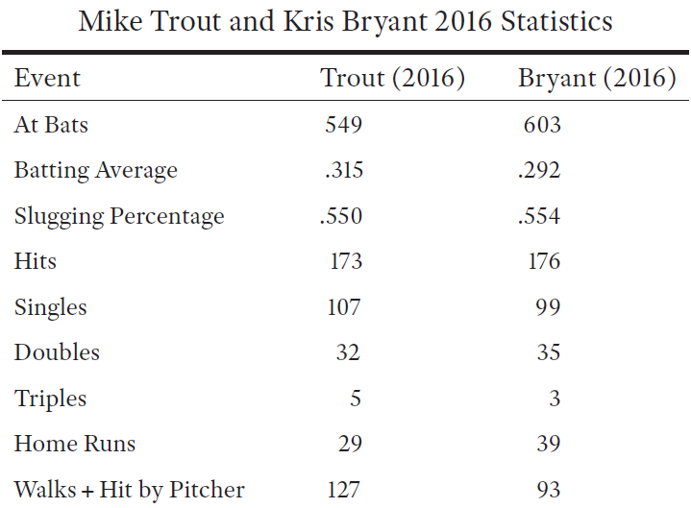
Runs-Created Approach
Motivation: Mike Trout Vs. Kris Bryant

Slide 6
Runs-Created Approach
H = Hit
S = Single
D = Double
T = Triple
HR = Home Run
AB = At-bat
BB = Walk
HBP = Hit-by-Pitch
Argument
Hitting Causes Good and Bad Things
Hits and Walks Create Scoring Opportunities
Better Hitter = More Scoring Opportunity
Relationship of Runs and {S,D,T,HR,BB,HBP}
Runs-Created Formula
Bill James (1979)
Recall: Total Bases (TB)
Formula:
$$TB≈S+2D+3T+4HR$$
$$RC≈\left(H+BB+HBP\right)×\frac{TB}{AB+BB+HBP}$$
# of Base Runners
Rate Players are Advancing

Slide 7
Runs-Created Approach
y = Actual Runs
y = Predicted Runs
n = Sample Size
Evaluation of Runs Created Formula
Evaluated For Teams from 2010 to 2016
Off by About 21 Runs on Average
Average Team Scored 693 Runs in a Season
Error Measured as a Percentage is 3% (21/693)
Problem: Formula Developed Off Team Statistics
Results When Applied to Players
Model Based On Teams
Predict on Players
Playa and Year | Runs Created
Bryant 2016 | 129.09
Trout 2016 | 134.02
Cabrera 2013 | 147.54

Slide 8

Runs-Created Approach
RC = Runs Created
AB = At-bat
E = Errors
H = Hits
TO = Total Outs
GIDP = Double-Play
SF = Sacrifice Fly
SAC = Sacrifice Bunt
CS = Caught Stealing
Runs Created Per Game
RC Flaw= Biased Toward Plate Appearances
Observation 1: 1.8% of AB are E
Observation 2: Additional Outs Caused by GIDP, SF, SAC, and CS
Observation 3: Sometimes 27 Outs Per Game
Observation 4: Following in Units of Game
$AB−H−\left(0.018\right)AB=\left(0.982\right)AB−H$
$TO=\left(0.982\right)AB−H+GIDP+SF+SAC+CS$
$$Average Outs Per Game=26.83$$
$$\frac{TO}{26.83}$$

Slide 9


Runs-Created Approach
RC = Runs Created
AB = At-bat
E = Errors
H = Hits
TO = Total Outs
GIDP = Double-Play
SF = Sacrifice Fly
SAC = Sacrifice Bunt
CS = Caught Stealing
Runs Created Per Game
Final Formula for RC/G
Interpretation of RC/G
Results Updated
$$\frac{RC}{G}=\frac{RC}{\frac{TO}{26.83}}$$
$$\frac{RC}{G}=\frac{Runs Created by Batter}{\# of Games Worth of Outs Used by Batter}$$
Playa and Year | RC | RC/G
Bryant 2016 | 129.09 | 8.11
Trout 2016 | 134.02 | 9.39
Cabrera 2013 | 147.54 | 10.6

Slide 10

America’s Greatest Pastime

Slide 11
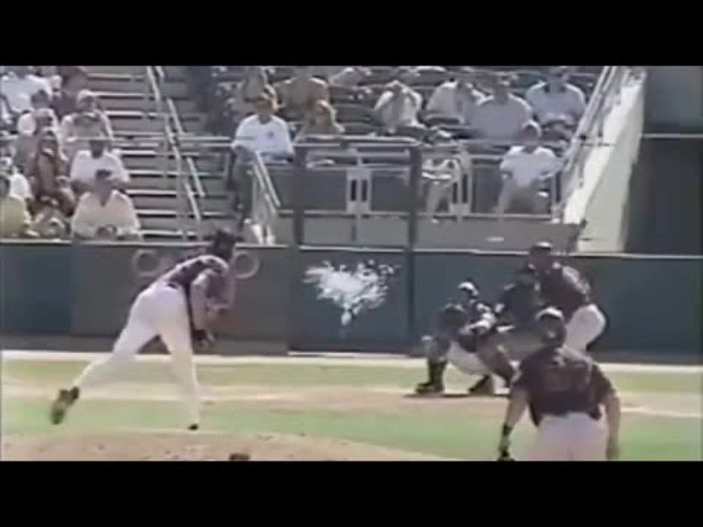
America’s Greatest Pastime

Slide 12

Final Inspiration
Well, it took me 17 years to get 3,000 hits in baseball, and I did it in one afternoon on the golf course.
- Hank Aaron

